Slide 1
Methylation QC reports for IMAGEN FU2, IMAGEN FU3, STRATIFY and ESTRA cohorts
Xinyang Yu
Updated on 06/06/2024

Slide 2
Overall methylation signals
IMAGEN FU2
IMAGEN FU3
In general, all samples have good signals.
*An example of outliers beyond 3 SD that will be removed in the QC.

Slide 3
Overall methylation signals
STRATIFY
ESTRA

Slide 4
For sex effect on the overall methylation signals Samples are coloured by sex
IMAGEN FU2
IMAGEN FU3
STRATIFY
*Here again, some outliers were identified. They will be removed in the following QC steps.

Slide 5
Predicting sex using methylation data
IMAGEN FU2
IMAGEN FU3
19 participants were removed
9 participants were removed

Slide 6
Predicting sex using methylation data
STRATIFY
ESTRA
All participants from ESTRA cohorts were predicted as females
6 participants were removed

Slide 7
PCA distribution
IMAGEN FU2
IMAGEN FU3
STRATIFY
ESTRA
The screen plots indicated the variances explained by components extracted.
PCA was conducted with methylation signals of all probes on autosomes.
The first 4 PCs were selected for further analyses as control variables (also matched with IMAGEN BL data).

Slide 8
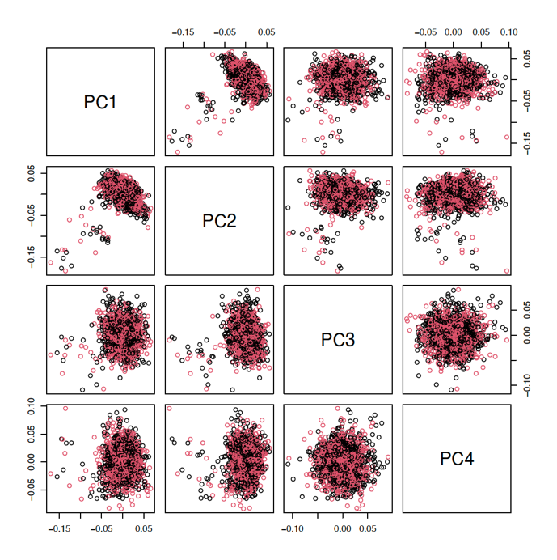
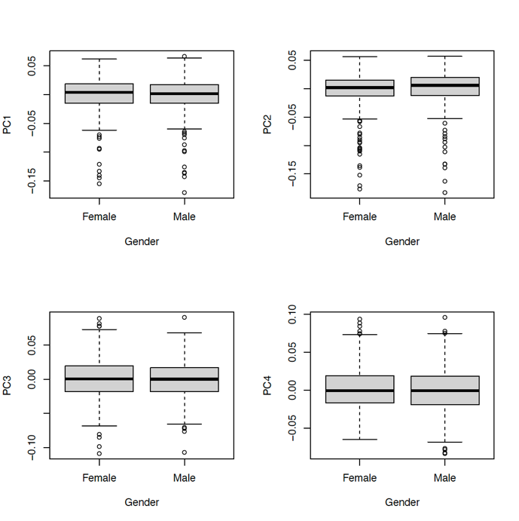
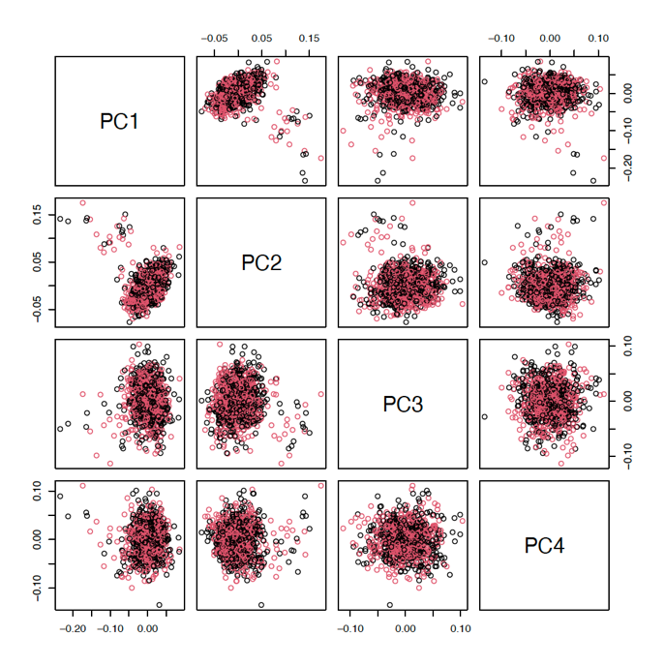
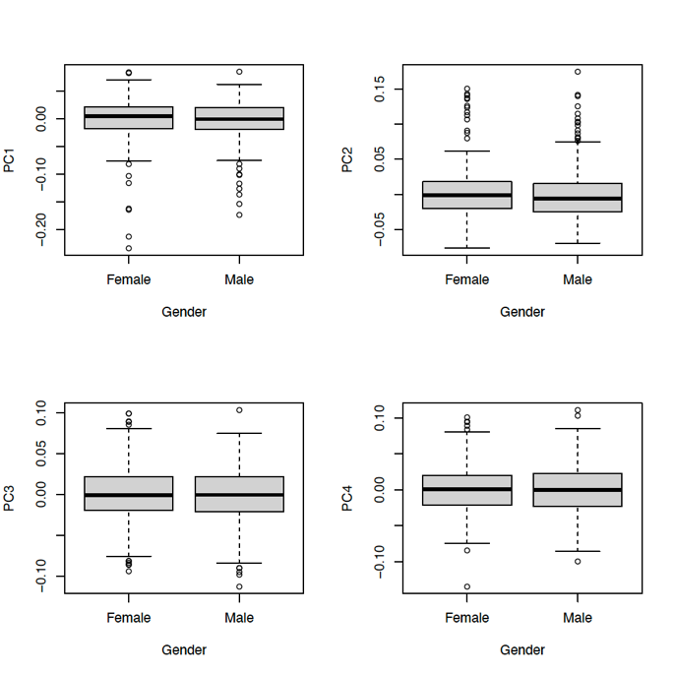
Evaluating batch effect: sex Samples are coloured by sex
IMAGEN FU2
IMAGEN FU3
No significant effects of sex on PCs of the methylation levels were found.

Slide 9
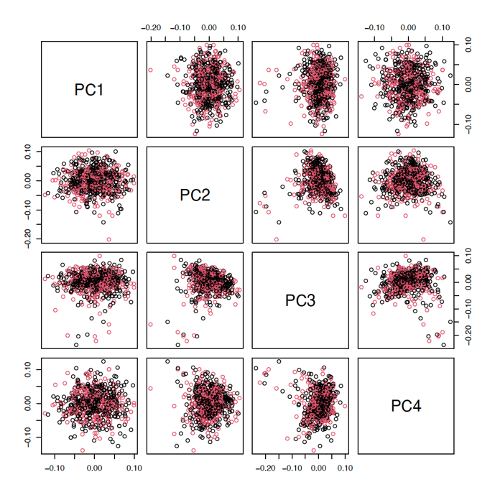
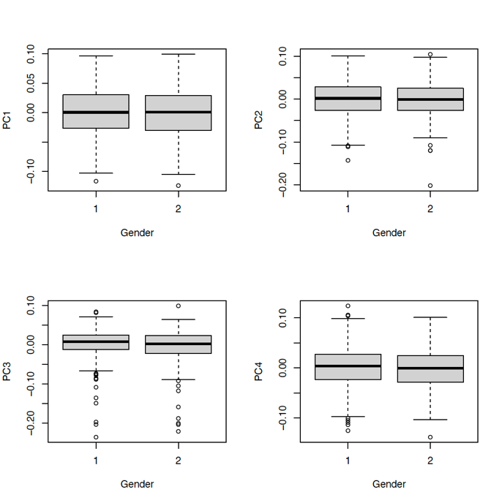
Evaluating batch effect: sex Samples are coloured by sex
STRATIFY
No significant effects of sex on PCs of the methylation levels were found.

Slide 10
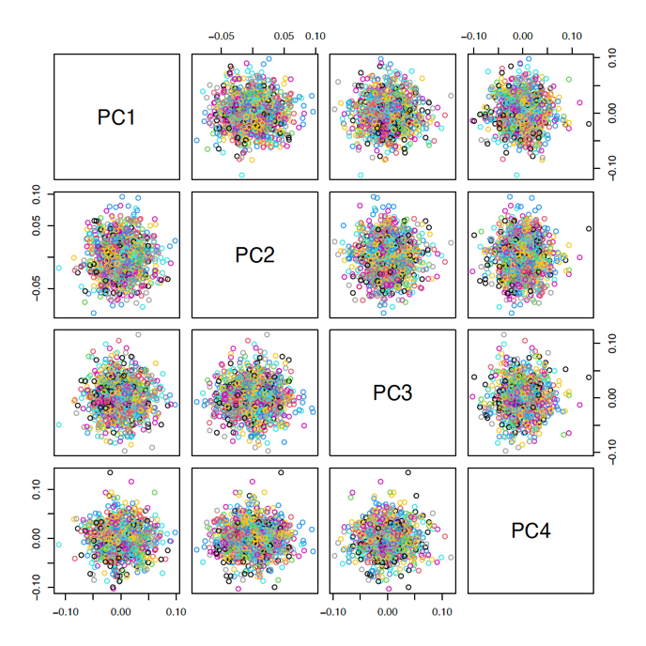
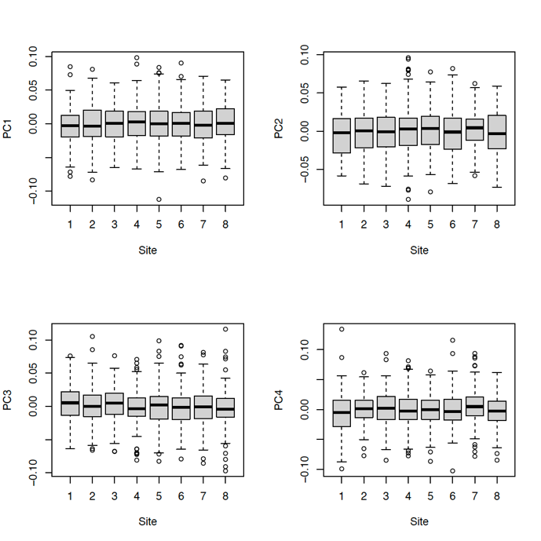
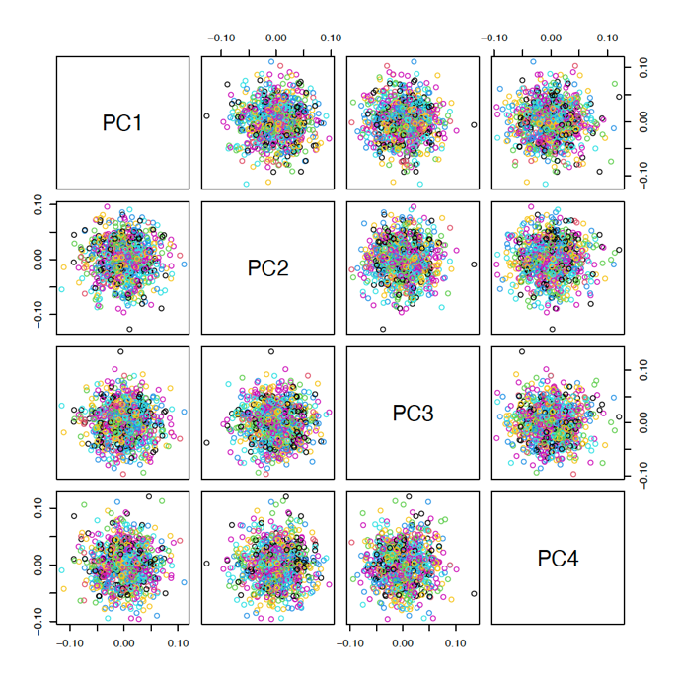
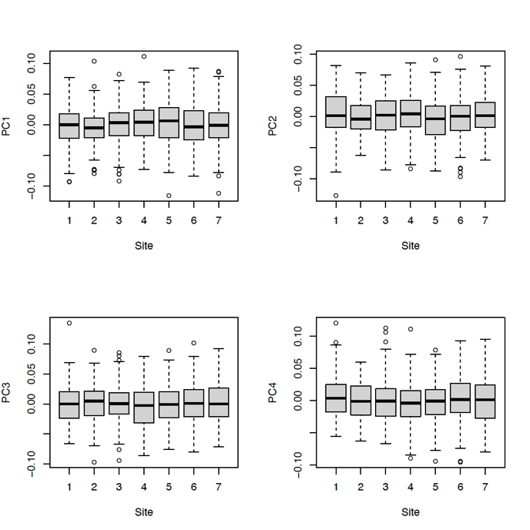
Evaluating batch effect: recruitment sites Samples are coloured by recruitment sites
IMAGEN FU2
IMAGEN FU3
No significant effects of recruitment sites on PCs of the methylation levels were found.

Slide 11
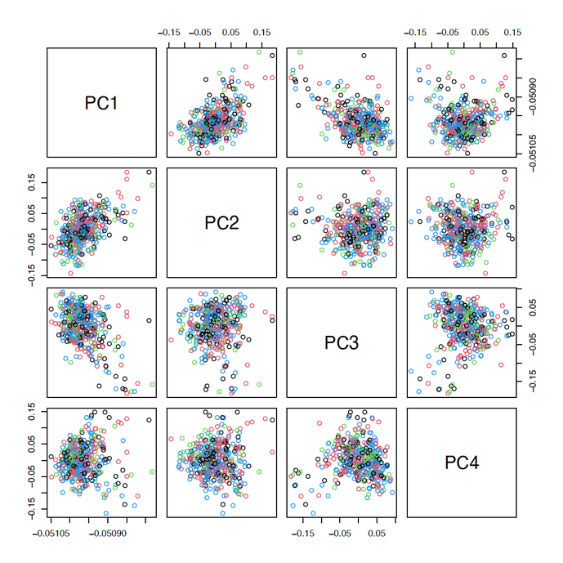
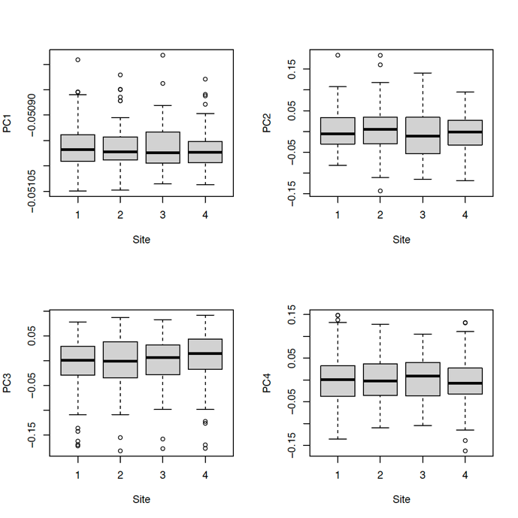
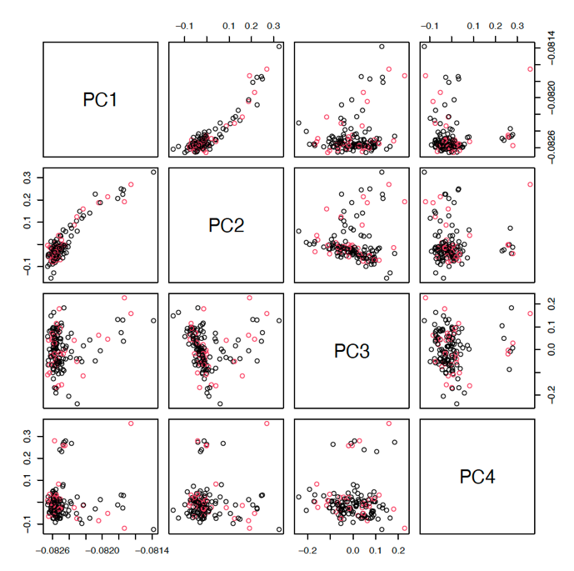
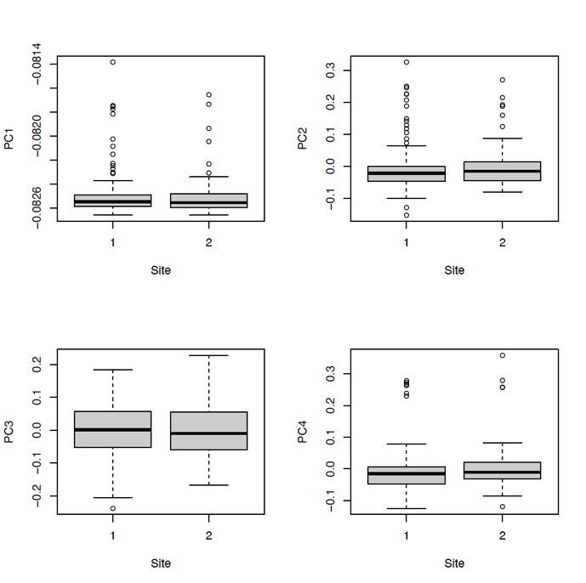
Evaluating batch effect: recruitment sites Samples are coloured by recruitment sites
STRATIFY
ESTRA
No significant effects of recruitment sites on PCs of the methylation levels were found.

Slide 12
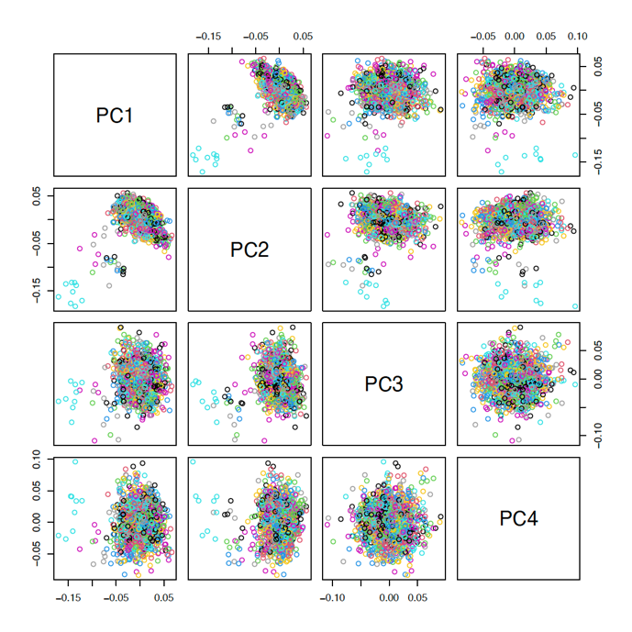
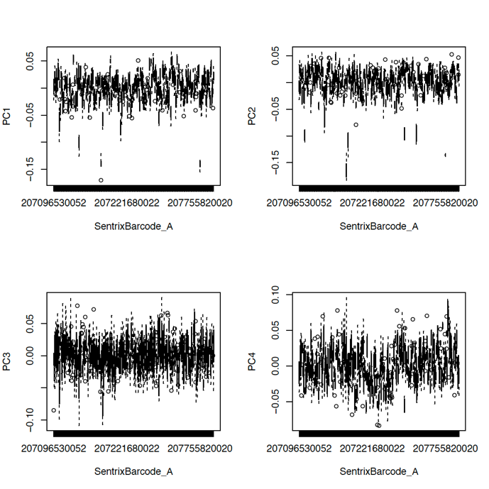
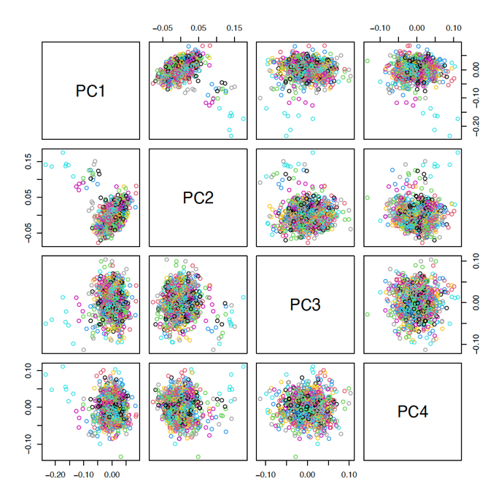
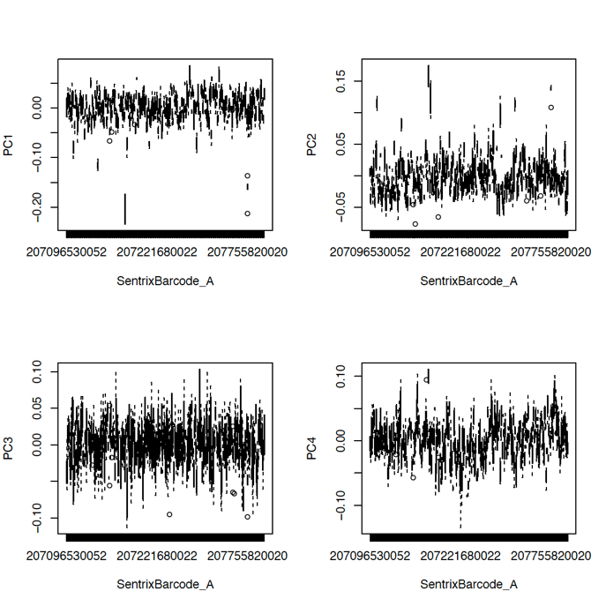
Evaluating batch effect: slides (barcodes of the plate) Samples are coloured by slides
IMAGEN FU2
IMAGEN FU3
No significant effects of slides on PCs of the methylation levels were found.

Slide 13
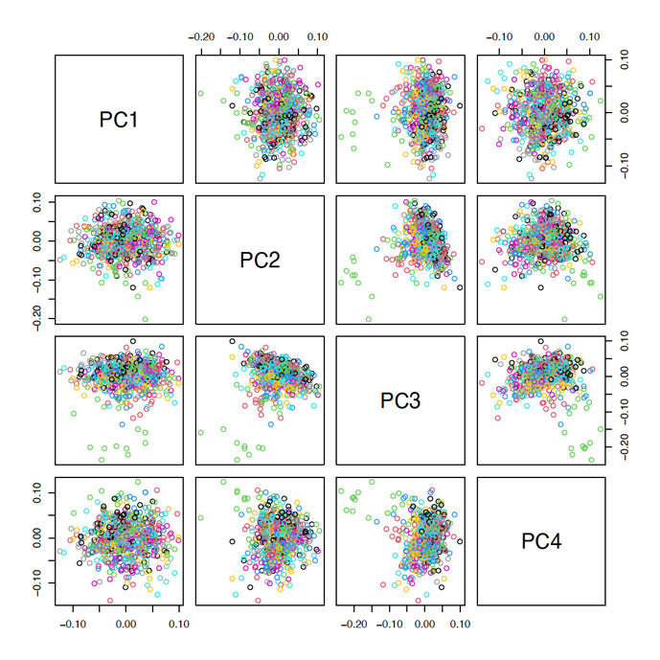
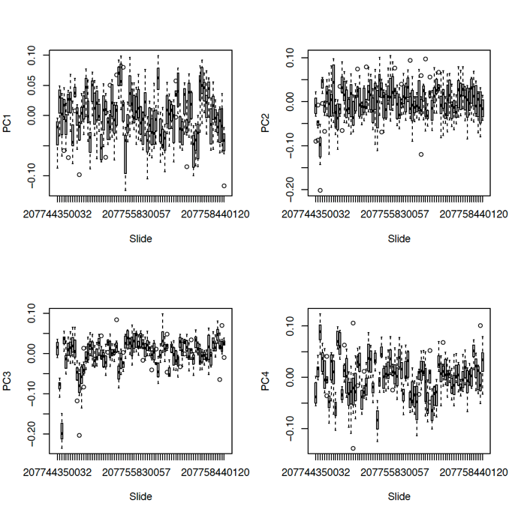
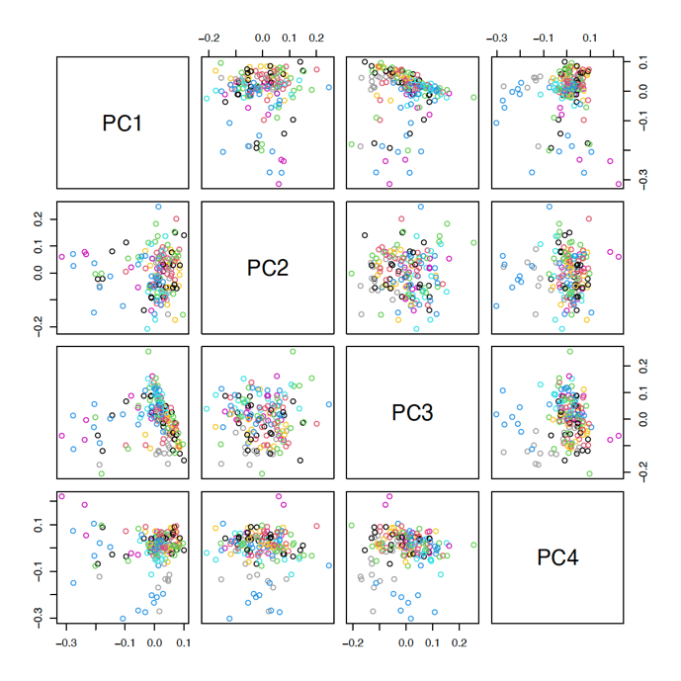
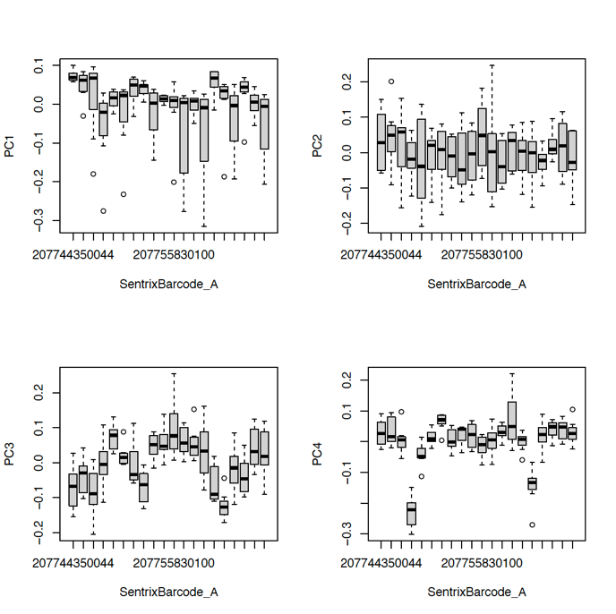
Evaluating batch effect: slides (barcodes of the plate) Samples are coloured by slides
STRATIFY
ESTRA
There were weak effects of slides on the 3rd PCs (and 4th PCs in ESTRA) of methylation data

Slide 14
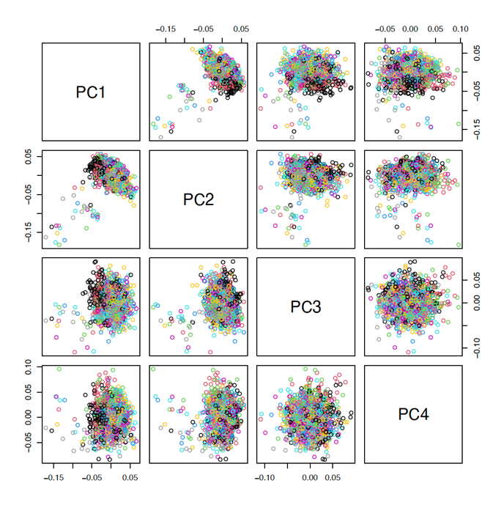
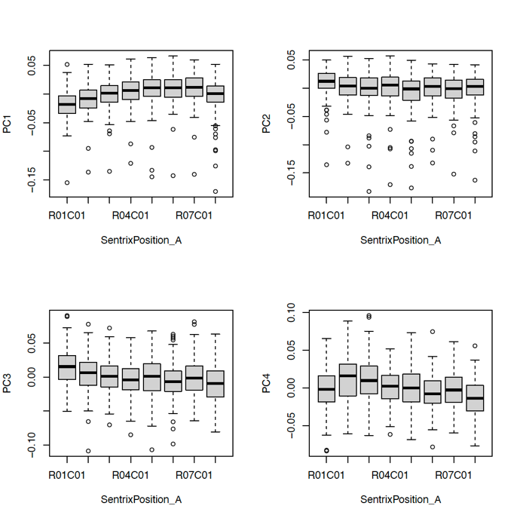
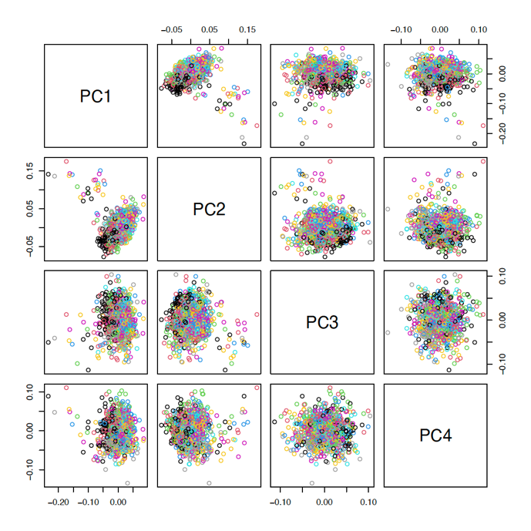
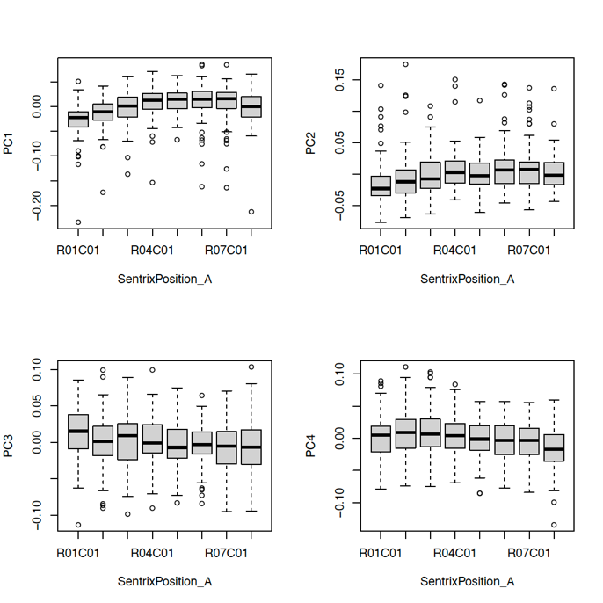
Evaluating batch effect: location (locations on the array) Samples are coloured by locations
IMAGEN FU2
IMAGEN FU3
No significant effects of slides on PCs of the methylation levels were found.

Slide 15
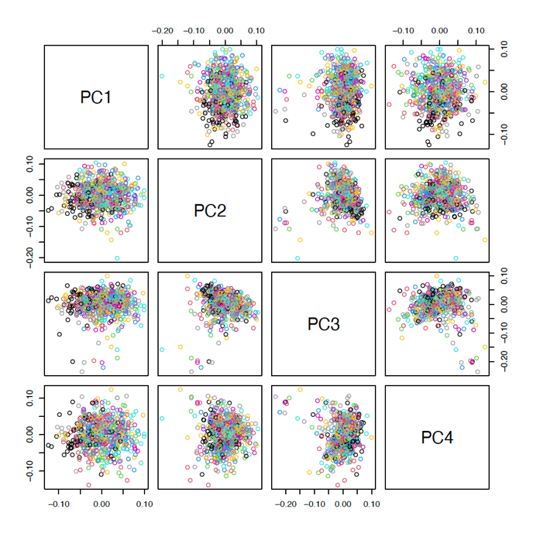
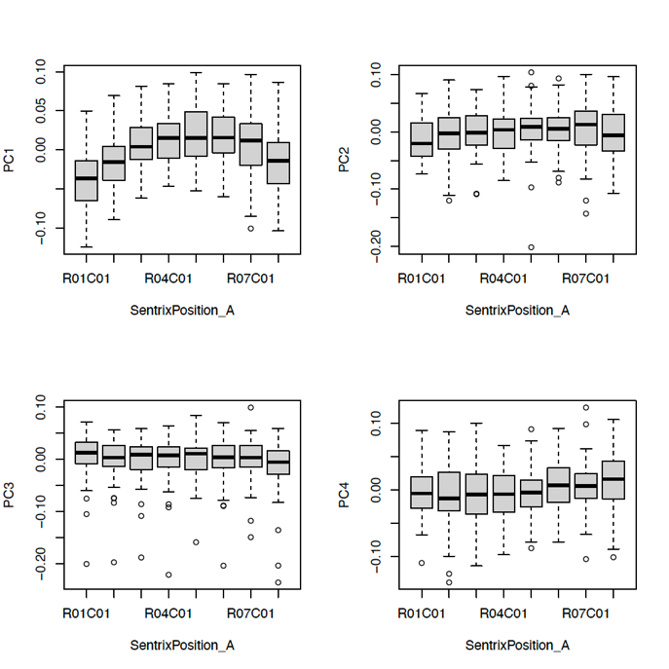
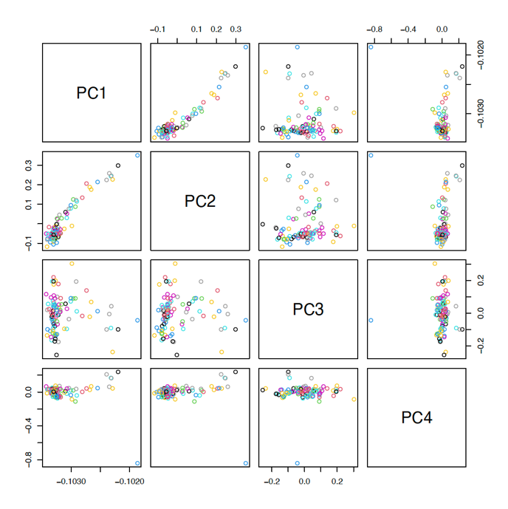
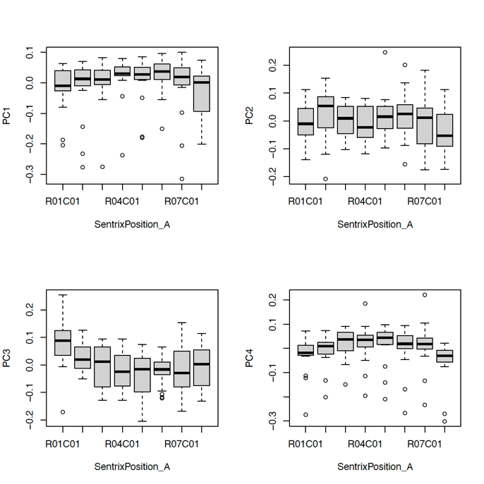
Evaluating batch effect: location (locations on the array) Samples are coloured by locations
STRATIFY
ESTRA
There were weak effects of slides on the 1st PC for STRATIFY and 3rd PC for ESTRA of their methylation data

Slide 16
Estimated cell proportion Note that FlowSorted.Blood.EPIC package (compared to the legacy FlowSorted.Blood.450k package) uses Neutrophils instead of Granulocytes. When using the newer EPIC microarray minfi estimates of cell type composition using the FlowSorted.Blood.450k package are less precise compared to actual cell counts (doi:10.1186/s13059-018-1448-7.)
IMAGEN FU2
IMAGEN FU3

Slide 17
Estimated cell proportion
STRATIFY
ESTRA

Slide 18
PCA distribution of cell proportion
IMAGEN FU2
IMAGEN FU3
STRATIFY
ESTRA
The first two PCs were derived for downstream analyses as covariates.

Slide 19
Notes
Sample size
 | IMAGEN FU2 | IMAGEN FU3 | STRATIFY | ESTRA
Initial numbers received from L&B | 1332 | 943 | 614 (incl. IMAGEN controls) | 160 (incl. IMAGEN controls)
Removed due to outliers | 37 (2.78%) | 31 (3.29%) | 14 (2.28%) | 13 (8.13%)
Removed due to sex mismatch | 19 (1.43%) | 9 (0.95%) | 6 (0.98%) | 0
Removed due to duplicate records | 5 (0.38%) | 0 | 0 | 0
Final numbers | 1271 (95.42%) | 903 (95.75%) | 594 (incl. IMAGEN controls) 385 (w/o IMAGEN controls) | 147 (incl. IMAGEN controls) 94 (w/o IMAGEN controls)
Scripts used for preprocessing and QC: https://github.com/XinyangYu918/DNA-methylation-preprocessing.

